Slide 1

HEART DISEASE PREDICTION BASED ON PERSONAL KEY INDICATORS

Slide 2
Introduction
Heart disease may occur due to numerous reasons.
Some lifestyle factors and medical conditions can substantially increase the risk.
The recognition of the likelihood of encountering a heart disease can actually help.
A convenient method to get a likelihood prediction of having to confront a heart disease based on some key personal indicators.

Slide 3
Data for the Model
Column Name | Description
HeartDisease | Respondents that have ever reported having coronary heart disease (CHD) or myocardial infarction (MI)
BMI | Body Mass Index (BMI)
Smoking | Have you smoked at least 100 cigarettes in your entire life?
AlcoholDrinking | Heavy drinkers
Stroke | (Ever told) (you had) a stroke?
PhysicalHealth | how many days during the past 30 days was your physical health not good? (0-30 days)
MentalHealth | for how many days during the past 30 days was your mental health not good? (0-30 days)
DiffWalking | Do you have serious difficulty walking or climbing stairs?
Sex | Are you male or female?
AgeCategory | Fourteen-level age category
Race | Imputed race/ethnicity value
Diabetic | (Ever told) (you had) diabetes?
PhysicalActivity | physical activity or exercise done during the past 30 days other than their regular job
GenHealth | Would you say that in general your health is...
SleepTime | On average, how many hours of sleep do you get in a 24-hour period?
Asthma | (Ever told) (you had) asthma?
KidneyDisease | Were you ever told you had kidney disease?
SkinCancer | (Ever told) (you had) skin cancer?
Contains the needed details regarding personal key indicators for heart diseases
The dataset consists a total of 18 columns and 17 of them represent key indicators and risk factors for heart diseases.
The dataset originally comes form the Centres for Disease Control and Prevention (CDC)

Slide 4
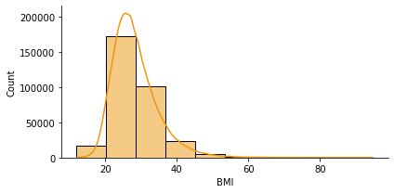
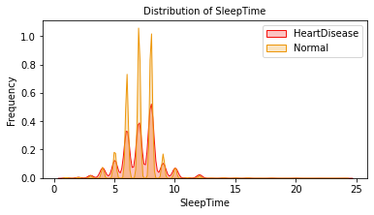
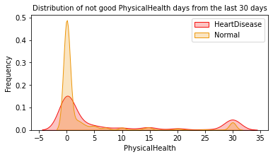
Exploratory Data Analysis
Histograms and KDE plots shown here depicts the distribution of the Numerical data.

Slide 5
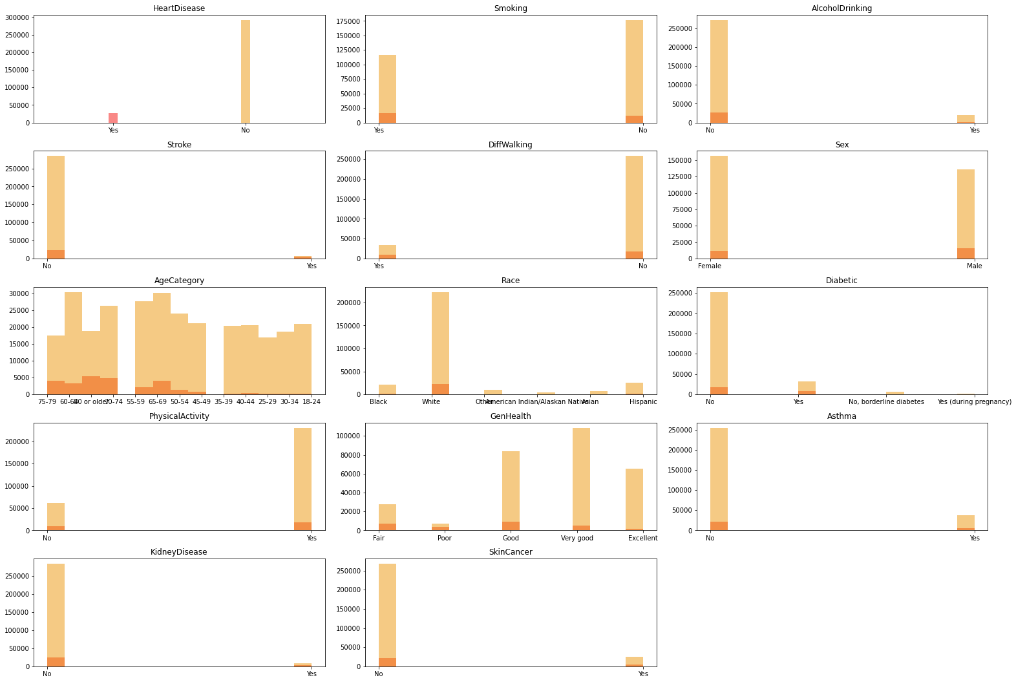
Exploratory Data Analysis
Histograms shown here represents the distribution of data of the categorical columns.

Slide 6
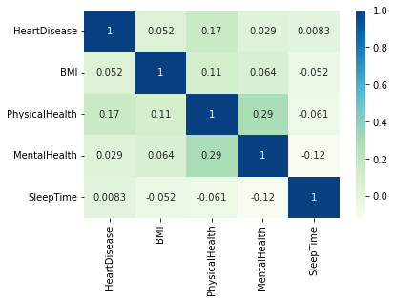
Exploratory Data Analysis
Heat map shown here represents the correlation between numerical columns.
Colour should become more thicker or darker when there is a higher correlation.

Slide 7
Feature Engineering
Newly Created Columns after One Hot Encoding
AgeCategory_18-24,AgeCategory_25-29, AgeCategory_30-34, AgeCategory_35-39, AgeCategory_40-44, AgeCategory_45-49, AgeCategory_50-54, AgeCategory_55-59, AgeCategory_60-64, AgeCategory_65-69, AgeCategory_70-74, AgeCategory_75-79, 'AgeCategory_80 or older'
Race_American Indian/Alaskan Native, Race_Asian, Race_Black, Race_Hispanic, Race_Other, Race_White
GenHealth_Excellent, GenHealth_Fair, GenHealth_Good, GenHealth_Poor, GenHealth_Very good
All the categorical columns have been one hot encoded in order to put into the model
Numerical column data went through a process of standardization.
For binary columns, a data type re-assignment was done to preserve the memory usage.

Slide 8
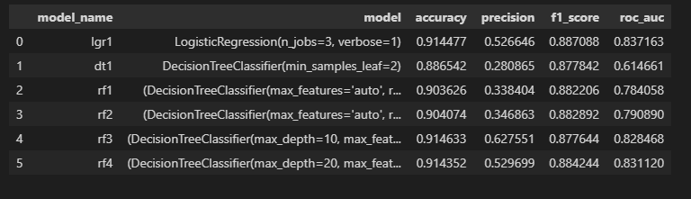
Model Training and Evaluation
6 models have been trained and evaluated.
The table shown here depicts the evaluation metric’s scores

Slide 9
THANK YOU
Kasun Dissanayake
dmkasun22@gmail.com

